Slide 1
DevOps Overview

Slide 2

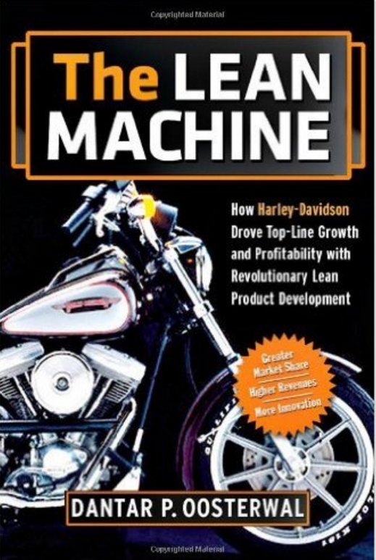
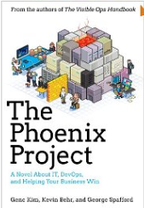
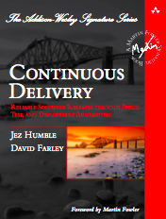
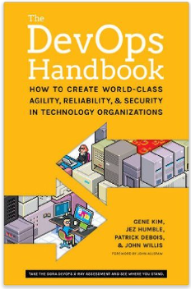
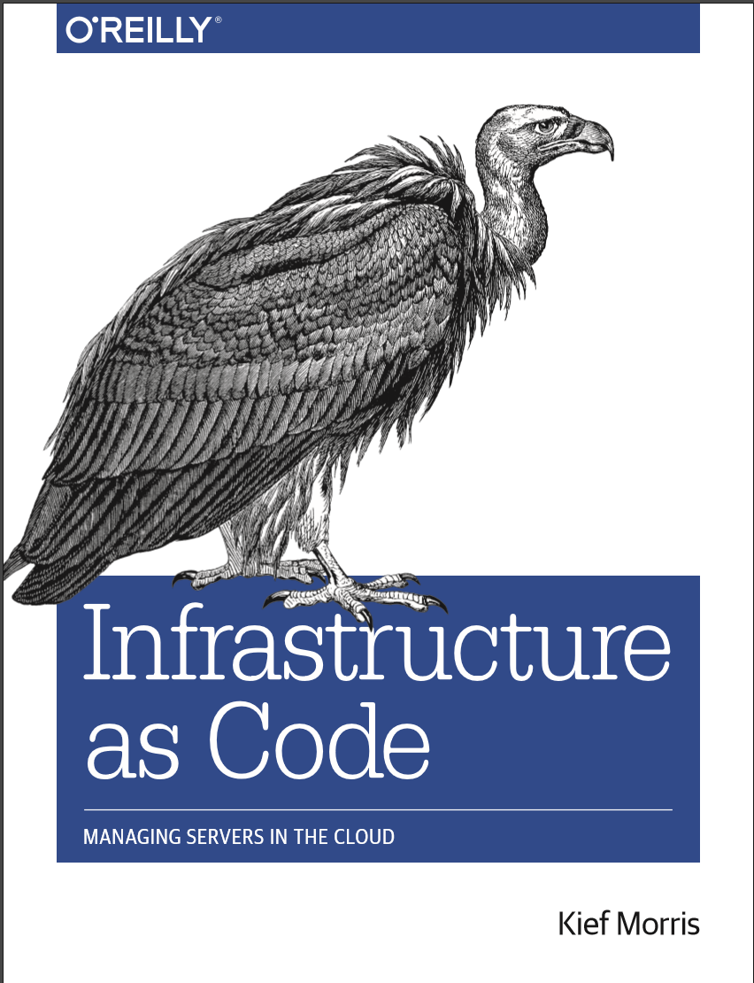
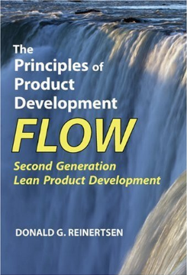
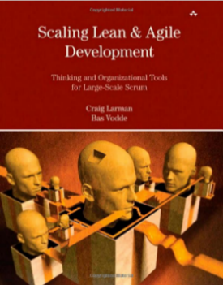
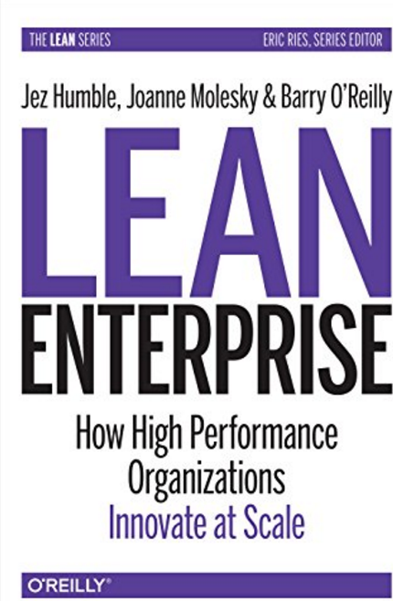
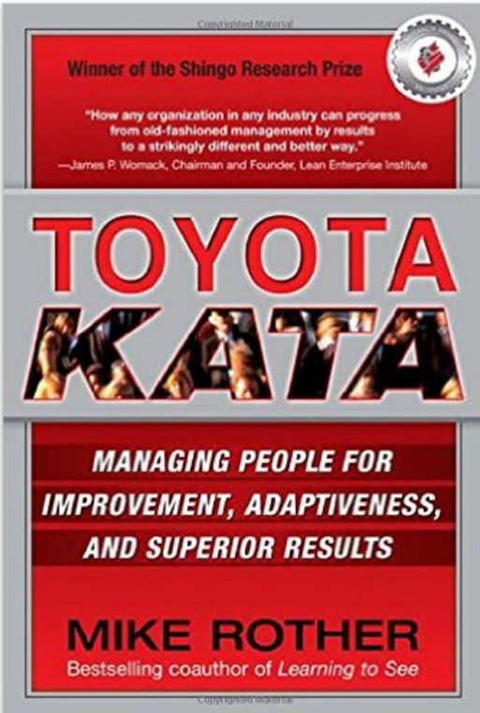

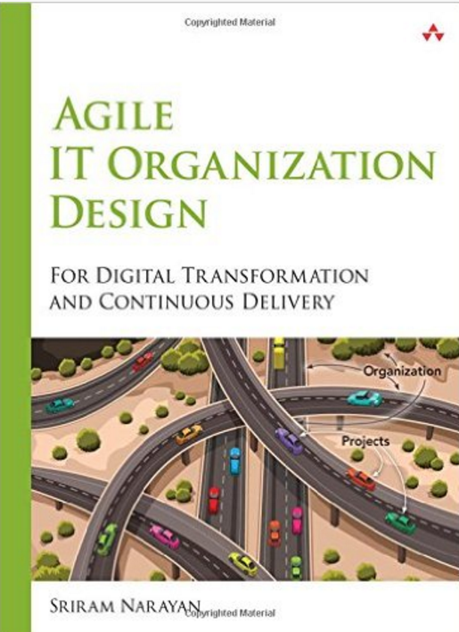
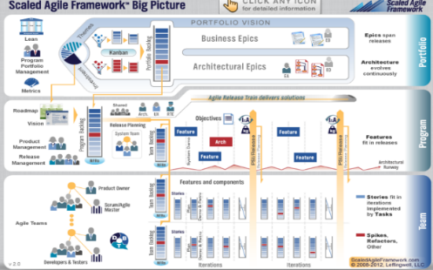
DevOps/Lean Bookshelf
2017
Fun
Practices
Foundational
www.scaledagileframework.com

Slide 3
What is DevOps?
3 minutes

Slide 4
What is DevOps?
DevOps is the combination of cultural philosophies, practices, and tools that increases an organization’s ability to deliver high quality services at high velocity and learn faster to delight their customers and compete effectively in the market.

Slide 5
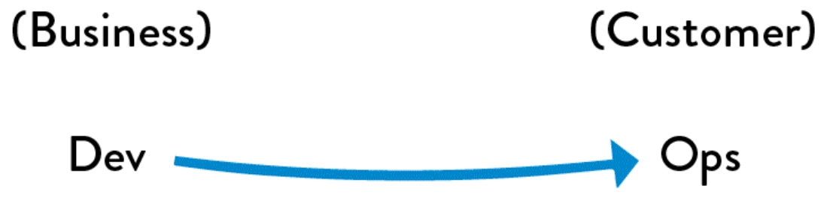
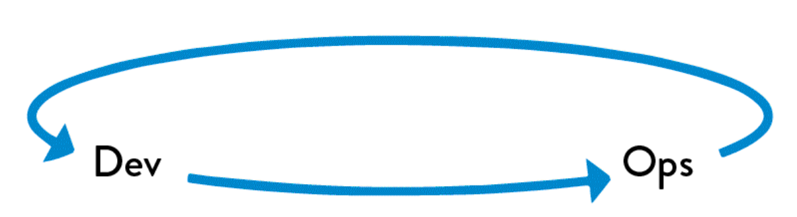

The Three Ways of DevOps
The Principles of Flow(Systems Thinking)
The Principles of Feedback
The Principles of Continual Learning

Slide 6
The First Way: Principles of Flow(Systems Thinking)
MAKE OUR WORK VISIBLE
LIMIT WORK IN PROCESS(WIP)
REDUCE BATCH SIZES
REDUCE THE NUMBER OF HANDOFFS
CONTINUALLY IDENTIFY AND ELEVATE OUR CONSTRAINTS
ELIMINATE HARDSHIPS AND WASTE

Slide 7
The Second Way: The Principles of Feedback
WORKING SAFELY IN COMPLEX SYSTEMS
SEE PROBLEMS AS THEY OCCUR
SWARM AND SOLVE PROBLEMS TO BUILD KNOWLEDGE
KEEP PUSHING QUALITY CLOSER TO THE SOURCE
ENABLE OPTIMIZING FOR DOWNSTREAM WORKCENTERS

Slide 8
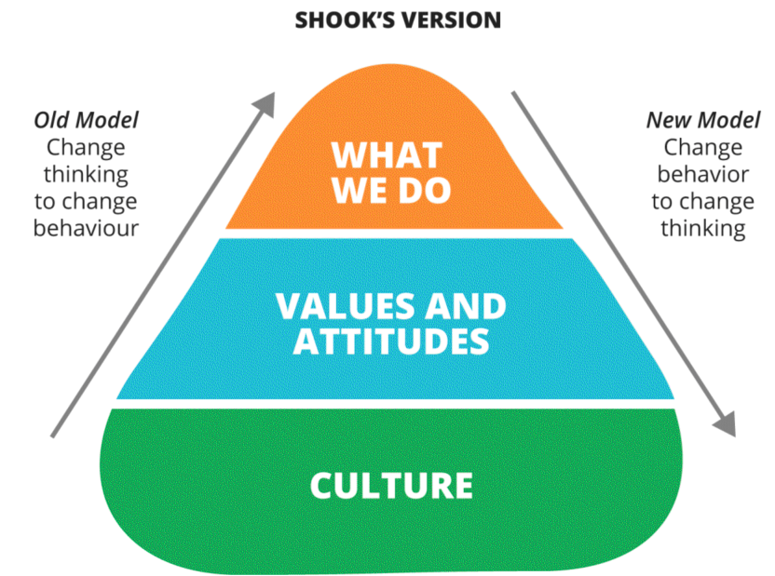
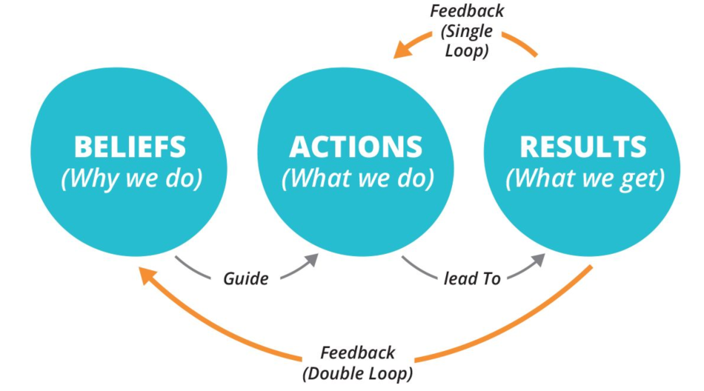
The Third Way: Continual Learning and Experimentation
ENABLE ORGANIZATIONAL LEARNING AND A SAFETY CULTURE
INSTITUTIONALIZE THE IMPROVEMENT OF DAILY WORK
TRANSFORM LOCAL DISCOVERIES INTO GLOBAL IMPROVEMENTS
INJECT RESILIENCE PATTERNS INTO OUR DAILY WORK
LEADERS REINFORCE A LEARNING CULTURE

Slide 9
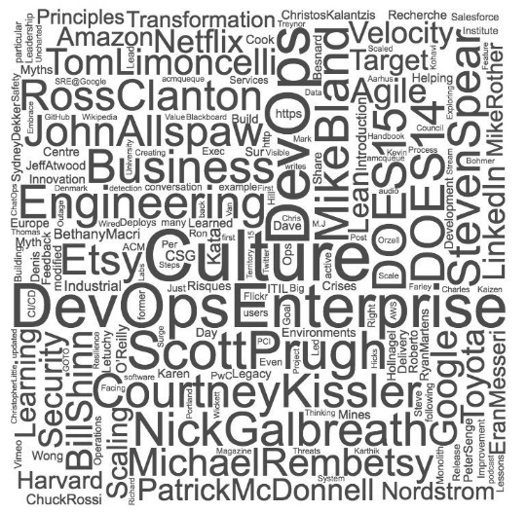
What are we doing at CSG?
Technical Practices of Flow
One Code Base Continually Integrated
Continuous Module Integration
Nightly Full System Integration & Testing
Cadence Based Production Delivery
Weekly to Quarterly
Infrastructure as Code / Security as Code
Operations Automation
Technical Practices of Feedback
Pervasive Telemetry at Scale
Telemetry Analytics
Safe Deploys(Blue/Green, Canary)
Service Owner Build & Run Teams
Localized Cab / Lightweight Coordination
Technical Practices of Continual Learning
Learning in Every Day Work
DevOps Community of Practice
Hackathons / Hackdays

Slide 10
When Ops Swallows Dev
Our Cultural and Technical Journey to Realize DevOps at CSG
2014
2015
2016
Pressures & Constraints
Demand for Quality & Speed
SoRs being pressured to become SoEs
Org & Process Debt, Technical Debt
Strive for Unimodal IT
Invest in:
Culture, Empathy, Understanding,
Simplicity & Automation
Accelerate Feedback & Learning
Understanding
Accountability
Engineering
Techniques(v1)
Accelerate Learning & Lean Thinking
Inverse Taylor Maneuver
Inverse Conway Maneuver
Shared Service Continuous Delivery
Environment Congruency & Practice
Application Telemetry
Visualize Your Work
Work Release & WIP Limits
Cadence & Synchronization
Reduce Batch Size
Techniques(v2)
Holistically Improve Work Visibility
Incidents
Dependencies
Single Intake of Planned Work
Challenging Shared KPIs
Go See & Role Rotation
Infra as Code & Shared Understanding
Legacy Test Automation / ATDD
Telemetry & Shared Understanding
Journey and Principles
Org Archetype Journey 2012-2016 → Creating Service Delivery Teams
What we learned….
What is next…
YouTube: f4et0EGvKXA
YouTube: tKdIHCL0DUg
YouTube: 6afD-sQm03E
Scott Prugh, Chief Architect & VP Software Development & Operations, scott.prugh@csgi.com, @ScottPrugh
Erica Morrison, Director Software Development, erica.morrison@csgi.com, @ericarmorrison

Slide 11
DevOps Target Vision and Guiding Principles
Customer Focus & Delight
Improve Customer Experience & reduce impact by 80%
Improve delivery speed(cut lead time by 75%)
Deliver customer commitments
Understand and test end to end with our customer
Actively engage and challenge our customers to solve their business needs with dynamic solutions
1x1 Feature Flow
100% Value Add
Zero Impact & Customer Delight
Security for People and Customers
Vision
Modernization/Process
Optimize for speed and quality
Embrace Continuous Delivery & build for the Public Cloud
Simplify & deploy automation. No tasks/runbooks. More code.
Design from the front-of factory: More engineering, less duct-tape
Embrace IAC: Congruency desktop to cloud. Think cattle not pets
Embrace OSS/eliminate heavy and burdensome solutions
Design broad based fixes, build safe architectures, rehearse failure
No impact, small cycle time maintenance windows
Make system behavior visible: Deploy telemetry
Reduce technology variance(Buoys)/consolidate system redundancy
Commoditize access to data
API focused exposure. No direct access across systems
Integrate security into the product lifecycle
Enable data center mobility by 2019
Commoditize our code, reduce cost: 20(ZIIP)/10(GPU) by 2020
People
Spread Lean & Kata Thinking(Culture of Learning)
Encourage risk-taking, safe experimentation and knowledge
Encourage continuous and faster learning
Grow/Hire/Organize T and E-Shaped skills(people and teams)
Build a modern, high performance and flexible culture
Empower teams for Understanding, Accountability and Engineering
Remove handoffs, self-serve, eliminate helplessness
Initiate and Lead change with courage. Challenge the status quo.
Celebrate success
Model the behavior you want to see:
As Leaders we need to understand and model these principles. The people we lead will follow.
Notes:
75min

